Slide 1


Bank Marketing Campaign
Term Project (AASD 4001)
Group 2

Slide 2





Meet Our Crew
-Pranav Amarishkumar Amin
- Pinkush Gaba
- Pratik Gupta
- Priteshkumar Kanani
- Pranav Padhiyar
- Rashmi Pujara
- Diksha Shah
- Glenn Shaji Chirayil

Slide 3
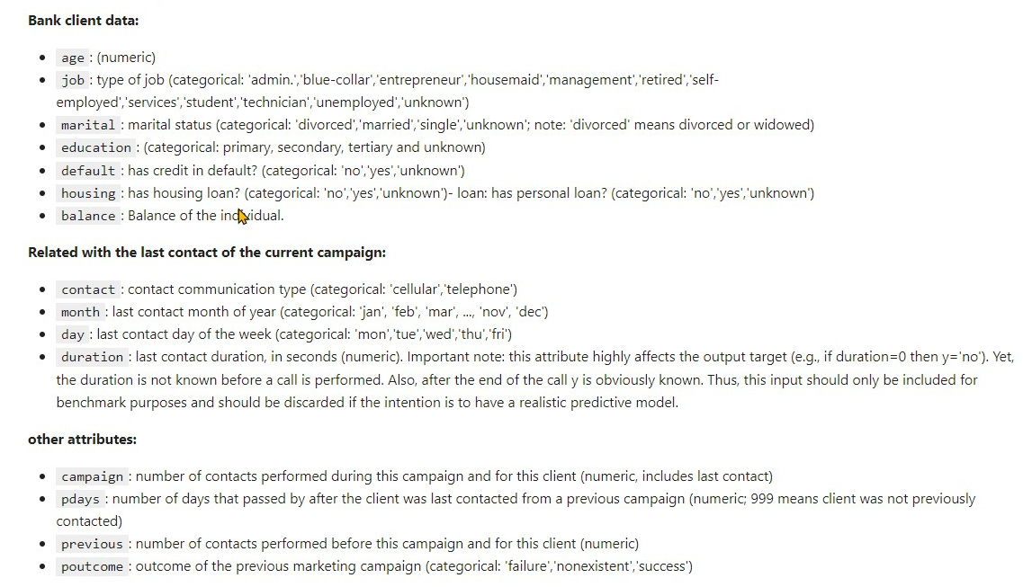
About Our DataSet
The data is related with direct marketing campaigns (phone calls) of a Portuguese banking institution. The classification goal is to predict if the client will subscribe a term deposit
In this dataset we explore which parameters help the bank to identify possible customer who will make a term deposit with the bank

Slide 4
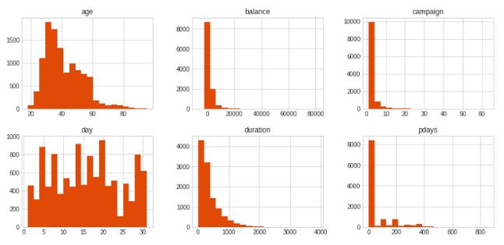
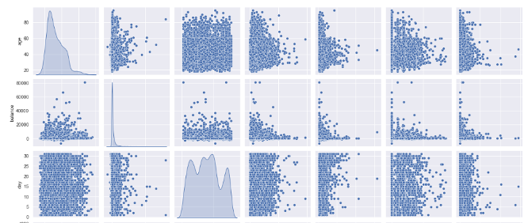
Exploratory Data Analysis
Helps in understanding the composition of the features and the relationship among them
Draws insights from the data
Histograms and distribution plots
Pair plots and boxplots
Feature engineering and model building

Slide 5
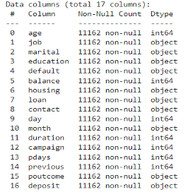
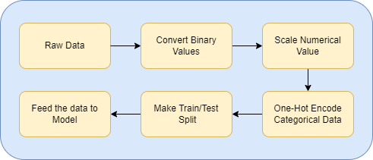
Data Pre-Processing
Dataset has 11,162 samples and almost equally divided in two classes.
Dataset contains 7 numerical values and 10 categorical values.
We are using binary labeling for yes/no columns, MinMaxScaler() for normalizing numerical values and One-Hot Encoding for categorical data.
After that we are using train_test_split with 30% being test data to get Train and Test datasets.

Slide 6
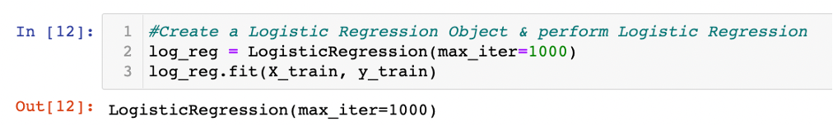
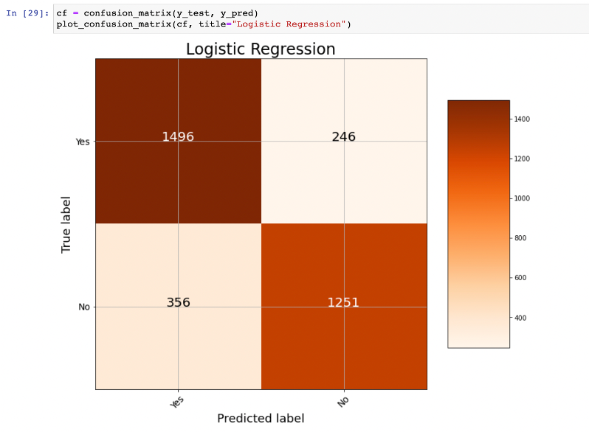
Logistic Regression:
Accuracy of Logistic Regression for our dataset:82.02%
Confusion Matrix –
Accuracy = TP+TN/(TP+TN+FP+FN)
Re-evaluation after dropping of columns/features(randomly):
Marital - 81.57%
Age - 82.05%
Education - 81.57%
Duration - 71.30%
Balance - 81.99%

Slide 7
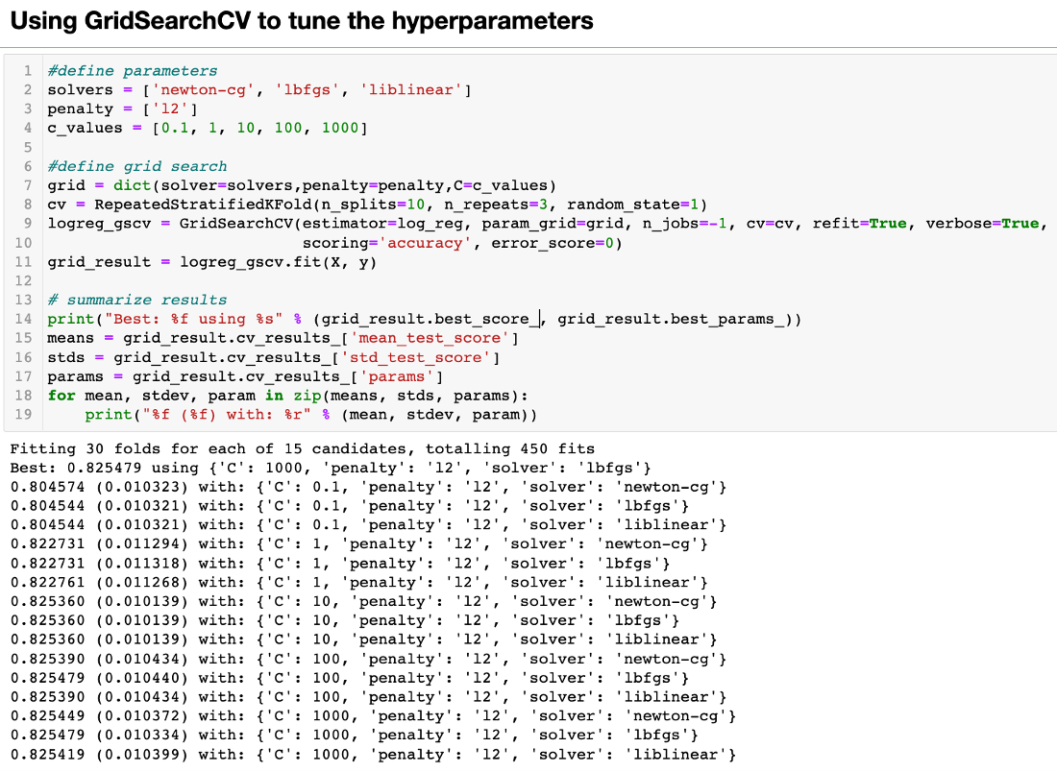
GridSearchCV for Logistic Regression:
GridSearchCV performs an exhaustive search
over specified parameter values
(solvers – ‘newton-cg,’ ‘lbfgs’, ‘liblinear’)
(penalty – ‘l2’)
(c_values – 0.1, 1, 10, 100, 1000)
for an estimator
(Logistic Regression algorithm in this case)
Best values for our dataset –
Mean – 0.825
C – 1000
Penalty – l2
Solver – lbfgs

Slide 8
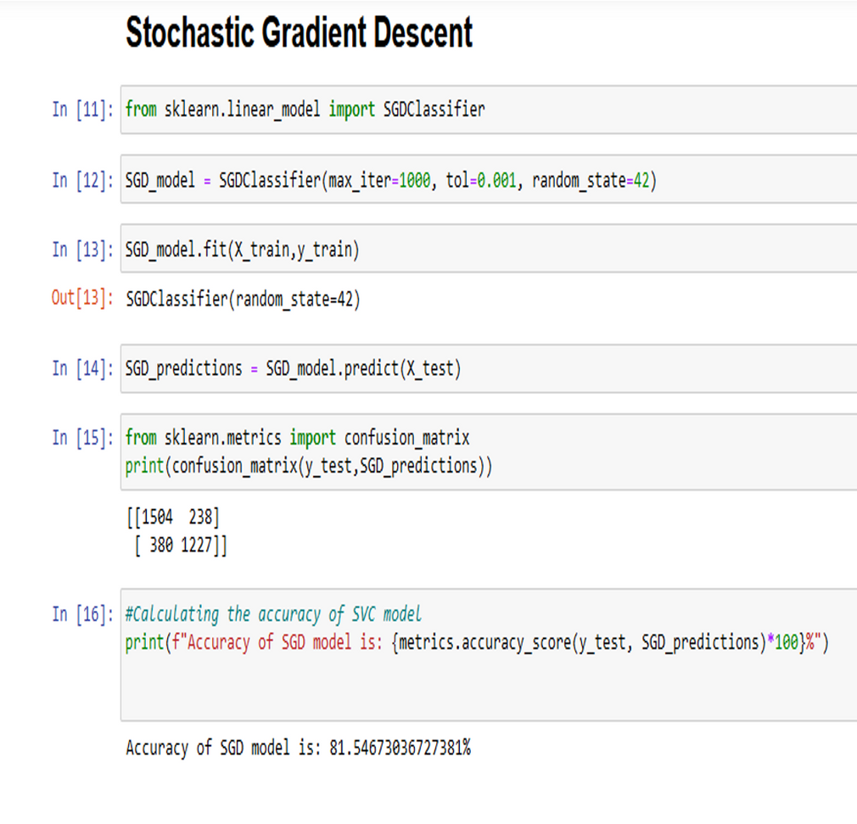
Stochastic Gradient Descent Classifier :
Accuracy of SGDClassifier for our dataset:
81.55 %
Confusion Matrix –
Accuracy = TP+TN/(TP+TN+FP+FN)
Re-evaluation after dropping of columns/features(randomly):
Job - 81.84%
Month - 80.20%
Campaign – 81.93%
Education – 81.46%
Age – 81.25%

Slide 9
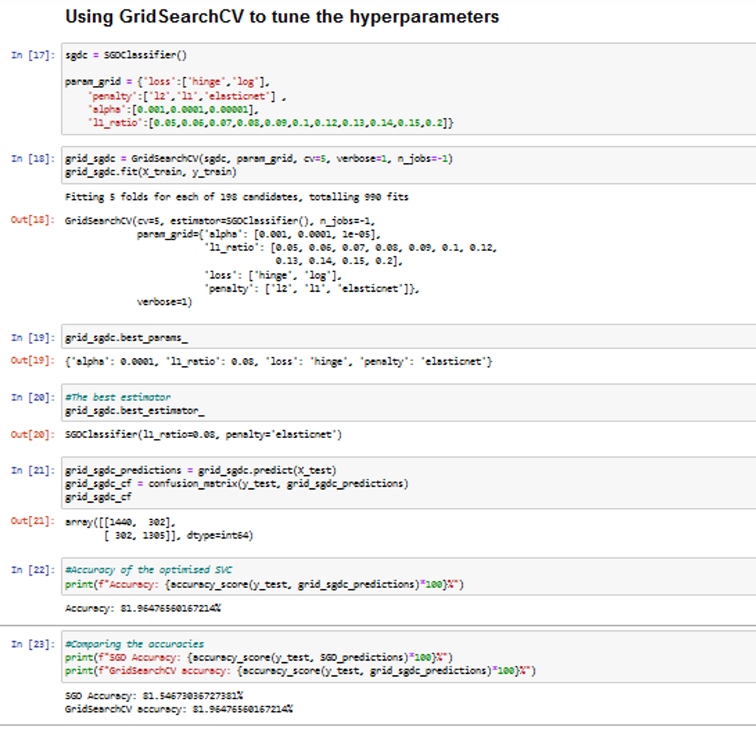
GridSearchCV for SGD:
GridSearchCV performs an exhaustive search
over specified parameter values
('loss':['hinge','log’])
('penalty':['l2','l1','elasticnet'])
('alpha':[0.001,0.0001,0.00001])
('l1_ratio':[0.05,0.06,0.07,0.08,0.09,0.1,
0.12,0.13,0.14,0.15,0.2])
for an estimator
( SGD algorithm in this case)
Best values for our dataset –
l1_ratio=0.08,
penalty=elasticnet
alpha = 0.0001
loss = hinge

Slide 10
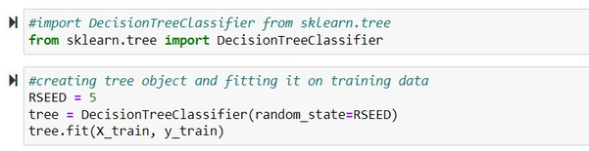
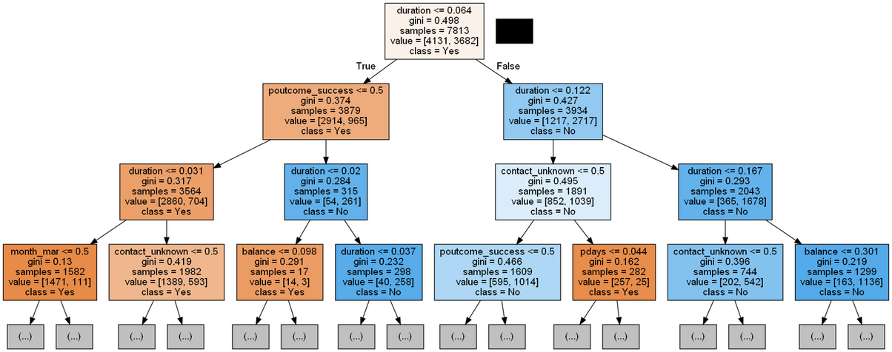
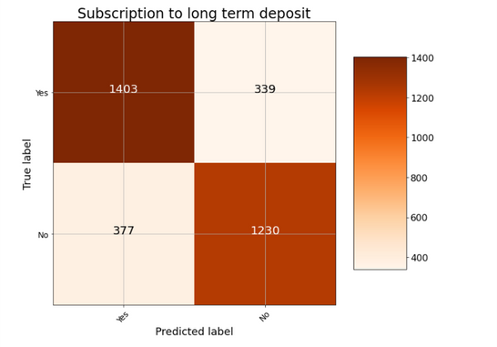
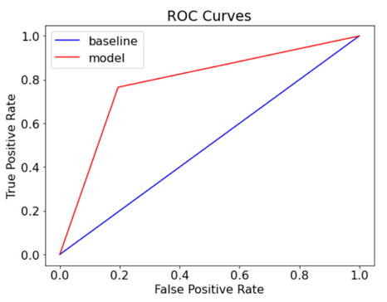
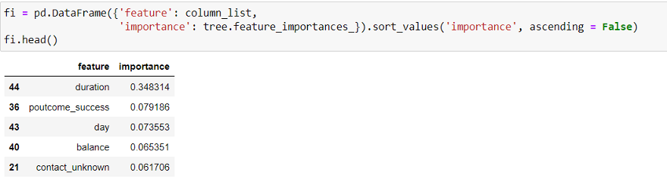
Decision Tree Classifier
Decision Tree with max_depth = 3

Slide 11
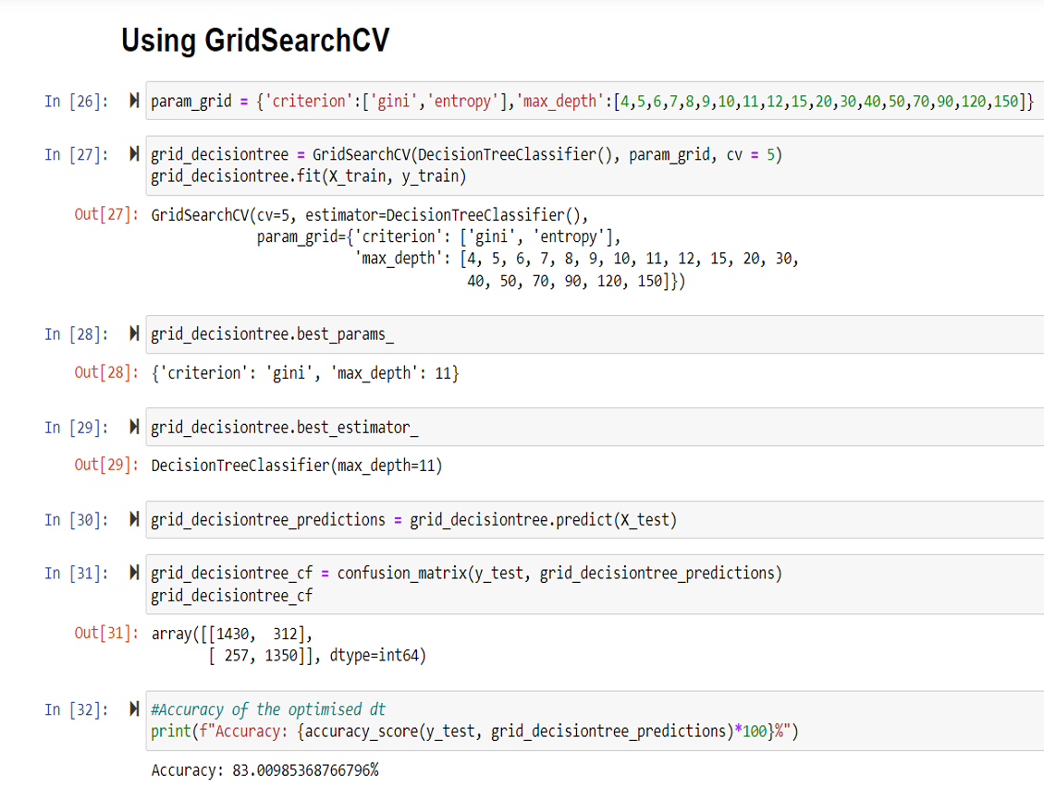
GridSearchCV for Decision Tree:
GridSearchCV performs an exhaustive search
over specified parameter values
'criterion':['gini','entropy’],
'max_depth':[4,5,6,7,8,9,10,11,12,15,20,30,
40,50,70,90,120,150]
Best values for our dataset –
'criterion': 'gini', 'max_depth': 11

Slide 12
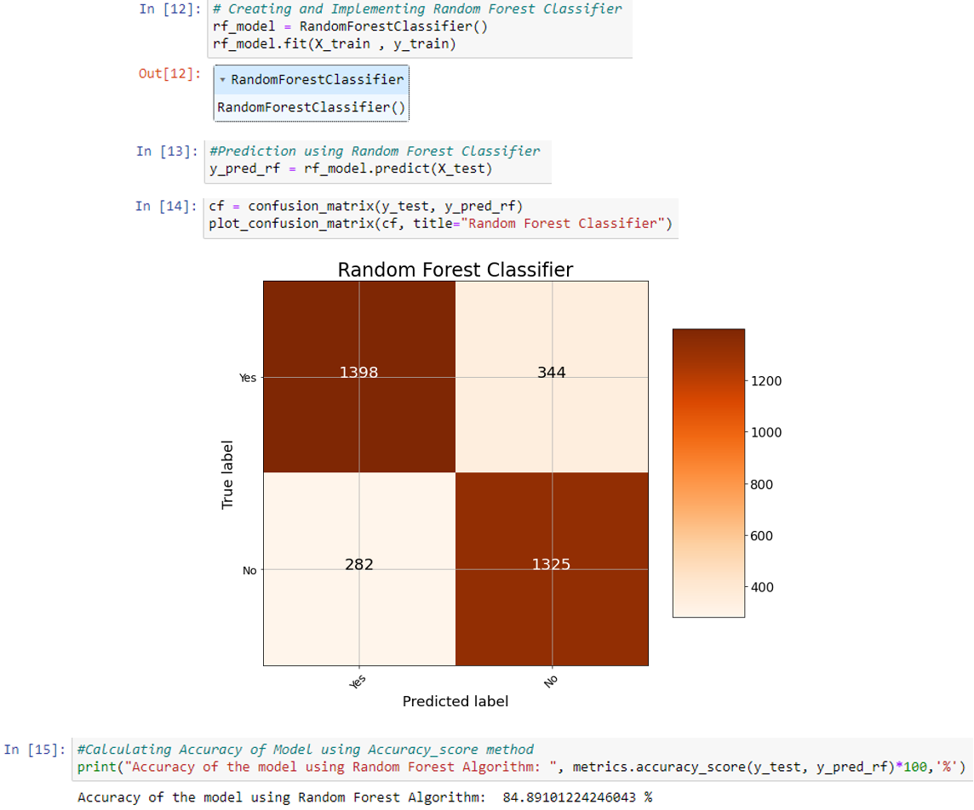
Random Forest Algorithm:
Accuracy of Random Forest Classifier for our dataset:
84.89%
Confusion Matrix –
Accuracy = TP+TN/(TP+TN+FP+FN)
Re-evaluation after dropping of columns/features(randomly):
Marital – 84.92%
Age – 85.21%
Education – 84.80%
Duration – 73.03%
Balance – 84.29%

Slide 13
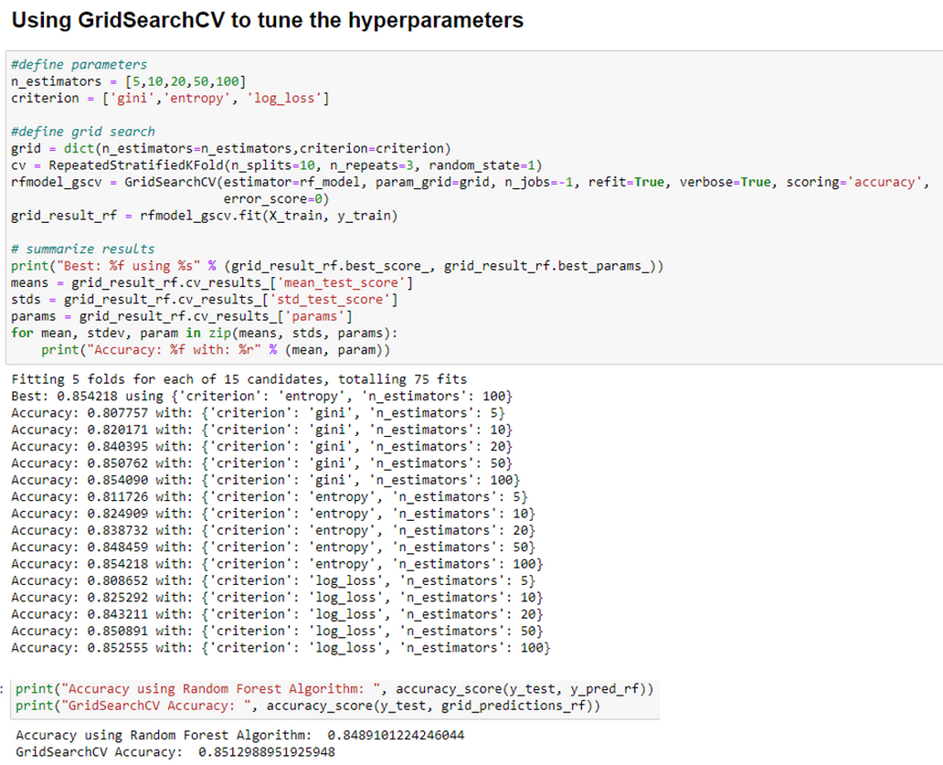
GridSearchCV for Random Forest Algorithm:
GridSearchCV performs an exhaustive search
over specified parameter values
(n_estimators – 5, 10, 20, 50, 100)
(criterion– ‘gini’, ‘entropy’, ‘log_loss’)
for an estimator
(Random Forest algorithm in this case)
Best values for our dataset –
n_estimators – 100
criterion – entropy

Slide 14
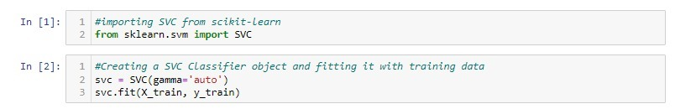
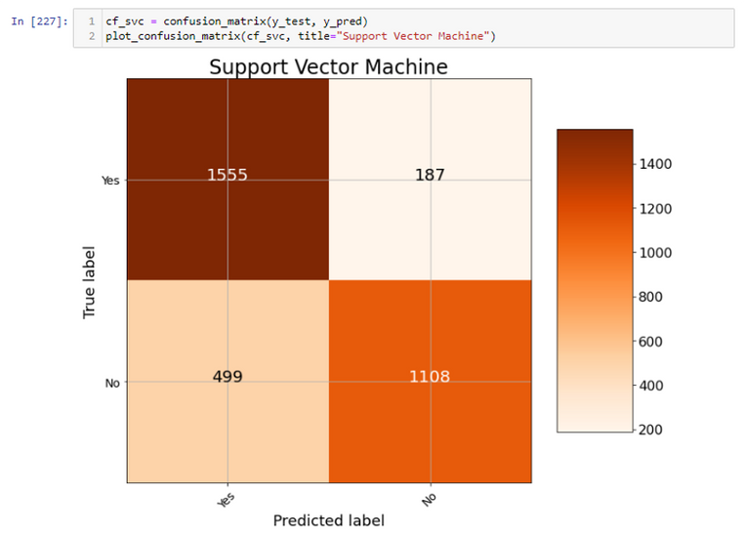
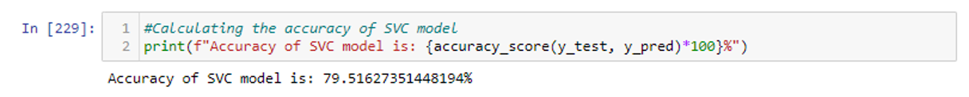
Support Vector Classifier:
Accuracy of SVC for our dataset:
79.52%
Confusion Matrix –
Accuracy = TP+TN/(TP+TN+FP+FN)
Re-evaluation after dropping of columns/features(randomly):
Job - 80.20%
Month - 77.87%
Campaign – 79.72%
Education – 79.99%
Age – 79.52%

Slide 15
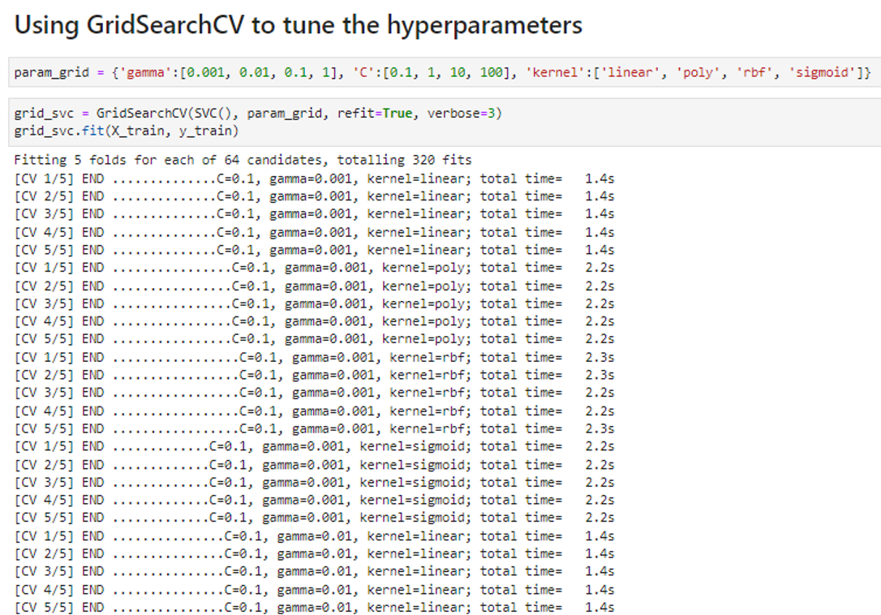
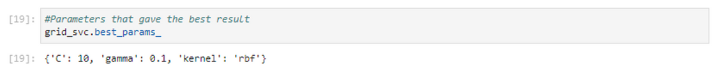
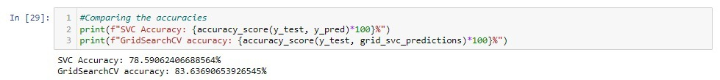
GridSearchCV for SVC:
GridSearchCV performs an exhaustive search
over specified parameter values
(Gamma – 0.001, 0.01, 0.1, 1)
(C – 0.1, 1, 10, 100)
(Kernel – ‘linear,’ ‘poly’, ‘rbf’, ‘sigmoid’)
for an estimator
(Support Vector Classifier algorithm in this case)
Best values for our dataset –
C – 10
Gamma – 0.1
Kernel - rbf

Slide 16

Thank you
Reference -
https://archive.ics.uci.edu/ml/datasets/bank+marketing

